Slide 1

Welcome to
University of Pennsylvania Coding Bootcamp
Wifi Network: Coding Class
Password - SASPennovation18!
Sign up for GitLab (if you haven’t already):
upenn.bootcampcontent.com
Open:
Slack desktop app & ADD PHOTO!
Log in to BCS:
Mark yourself present & ADD PHOTO!
Notes:
Review deck and update with relevant information.

Slide 2
By the end of this session, you will:
Come to know your classmates as the community that you will rely on for collaborative learning.
Know the staff who will be providing holistic support throughout the program.
Understand the minimum requirements in order to successfully graduate from this boot camp.
Be able to list ways to get help and support at your moments of need.
Notes:
Delivered by SSM:
These Objectives are overarching and include Launch + 1.1 integration.

Slide 3
Activity: Present & Accounted For
Navigate to www.bootcampspot.com
Sign in
Click Sessions
Find Today’s Date
Mark Your Attendance
Notes:
Everyone open your browser and let’s follow these steps:
Navigate to www.bootcampspot.com
Sign in with your log-in credentials
Click “Sessions”
Find Today’s Date
And last but not least, let’s mark the official start of our journey together!
Everyone Mark Your Attendance

Slide 4
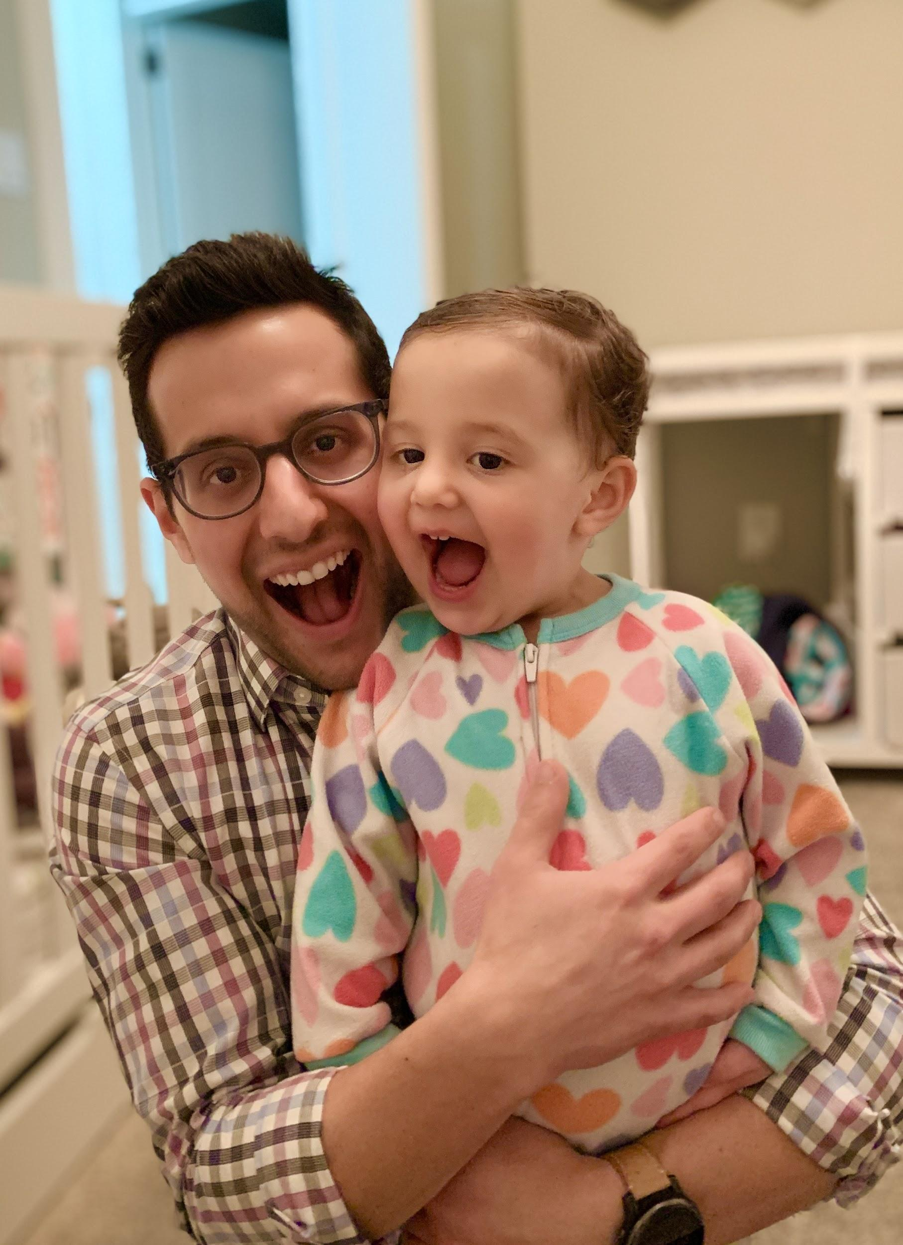
Josh Hochman
Student Success Manager (SSM)
My goal is simple: help you successfully complete the program!
jhochman@bootcampspot.com
Notes:
Delivered by SSM

Slide 5


Stacy Clements
Associate Director, Professional and Organizational Development,College of Arts and Sciences
stacymc@sas.upenn.edu
Notes:
Uni Partner Handoff:
Include Uni slides after this, if any.

Slide 6
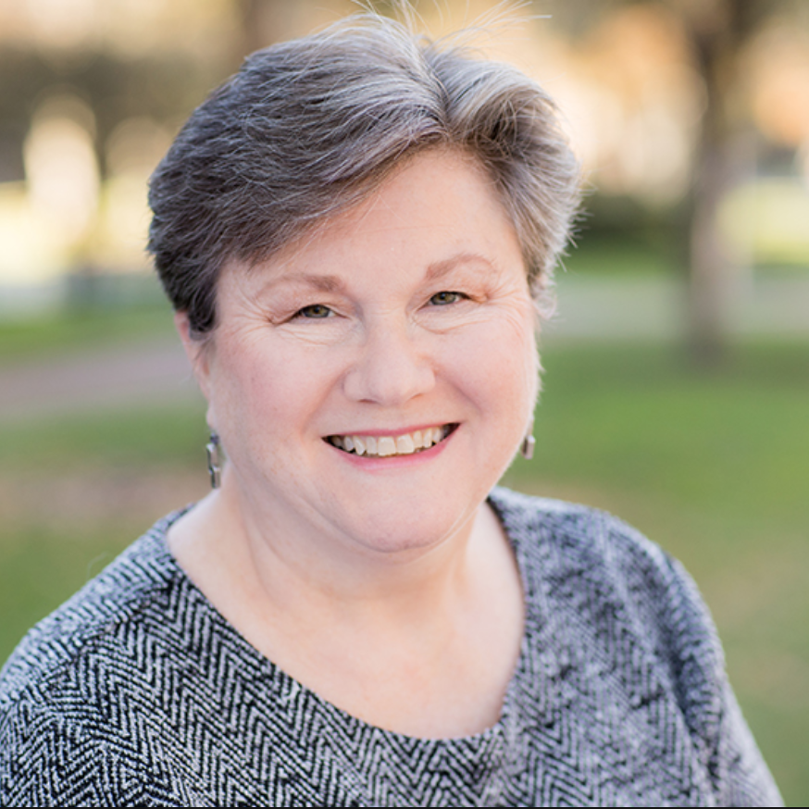
Rita McGlone
Executive Director, Professional and Organizational Development,College of Arts and Sciences
mcgloner@sas.upenn.edu
Notes:
Uni Partner Handoff:
Include Uni slides after this, if any.

Slide 7
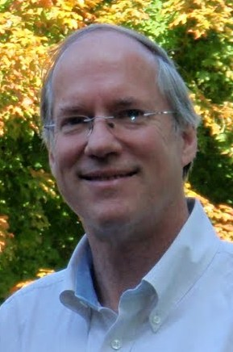
Dr. Robert Hollebeek
Professor Research Areas: Particle Physics, Proton Therapy
bobh@physics.upenn.edu
Notes:
Uni Partner Handoff:
Include Uni slides after this, if any.

Slide 8

Scott Wittrock
Teaching Assistant
Developer, designer, and entrepreneur
Previously worked at a number of tech companies including Slyce, Blippar, Ipreo, and Lumi
Supporter of cycling and public transit, love to travel, I'm a productivity and process enthusiast, nature lover and I'm most relaxed when cooking
Notes:
TA’s intro themselves

Slide 9
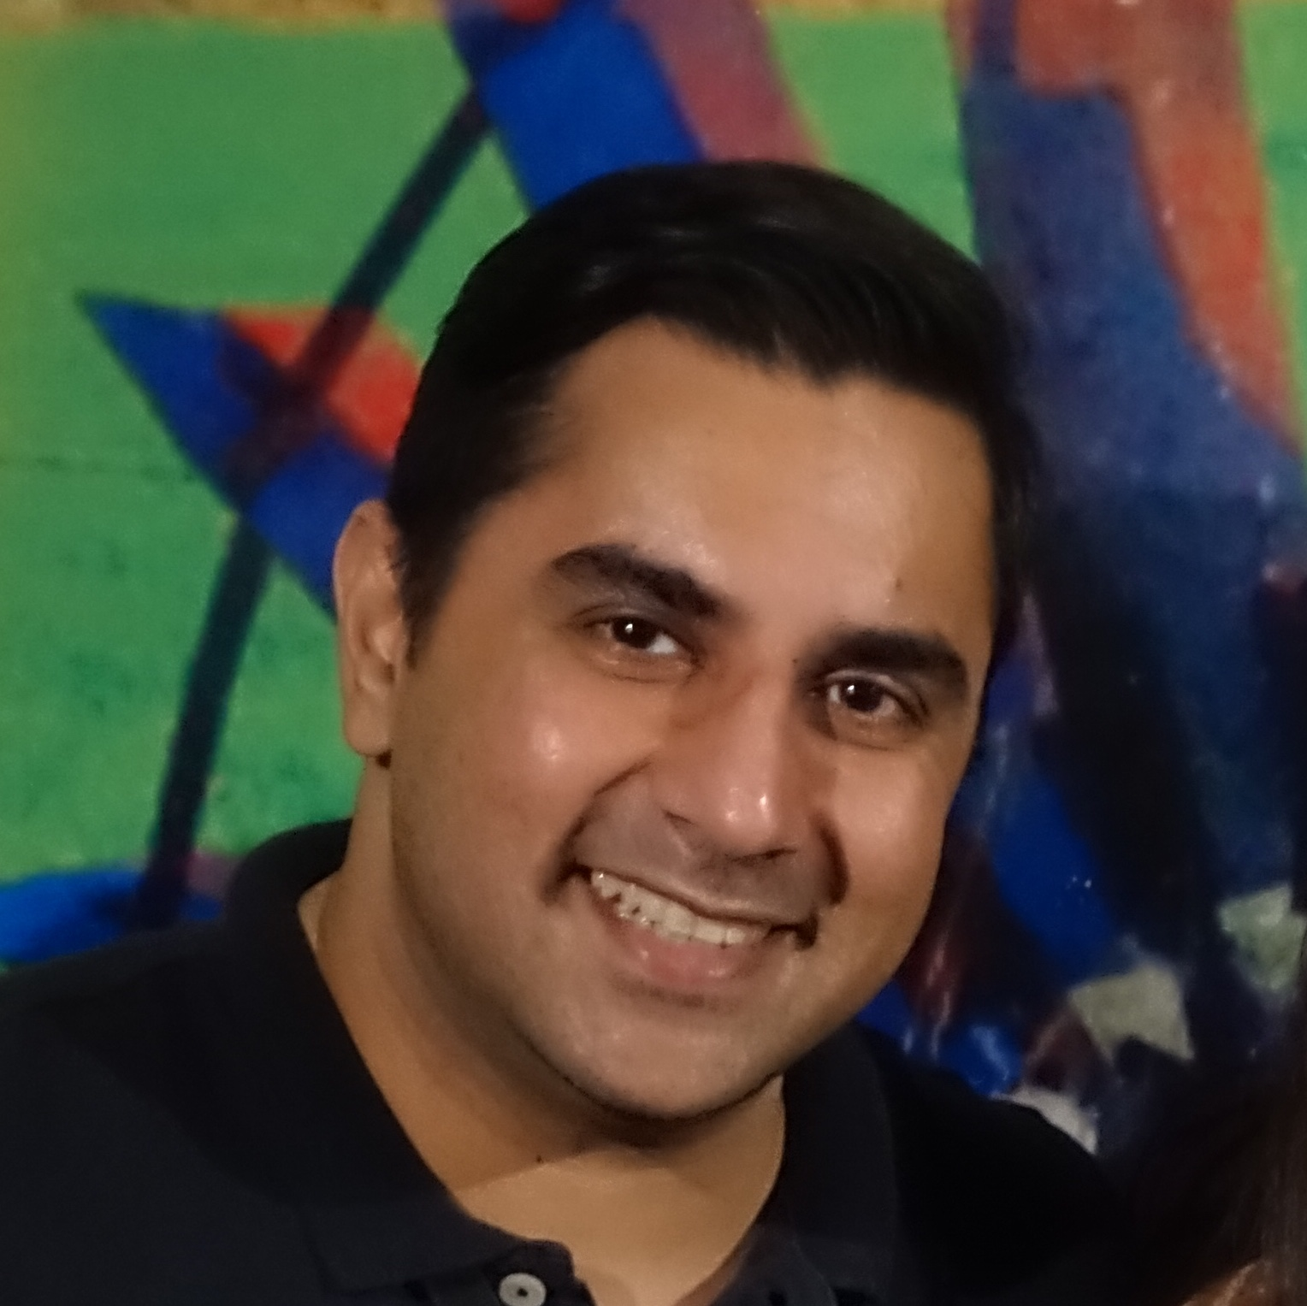
Vipinjeet Sandhu
Teaching Assistant
Learned how to program at age 8 on my Apple IIgs and have been in love with coding ever since!
Took formal classes in coding throughout my life and worked as a desktop programmer.
Extensive history teaching college students and adult learners in Computer Science
Through empathy and tenacity, I eternally chase an unending series of "aha!" moment and look forward to racking up more of those victories as your ally in your quest to become a full-stack developer.
Notes:
TAs intro themselves

Slide 10
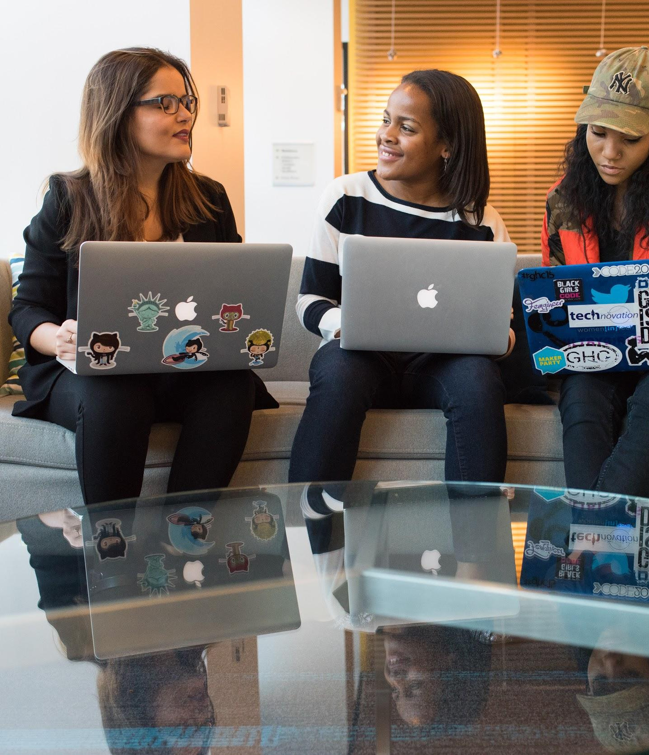
Your turn!
In 30 seconds or less, share your:
Name
Location
Background (Career, Education, Interests)
What excites you about this class!
Notes:
Student Intros

Slide 11
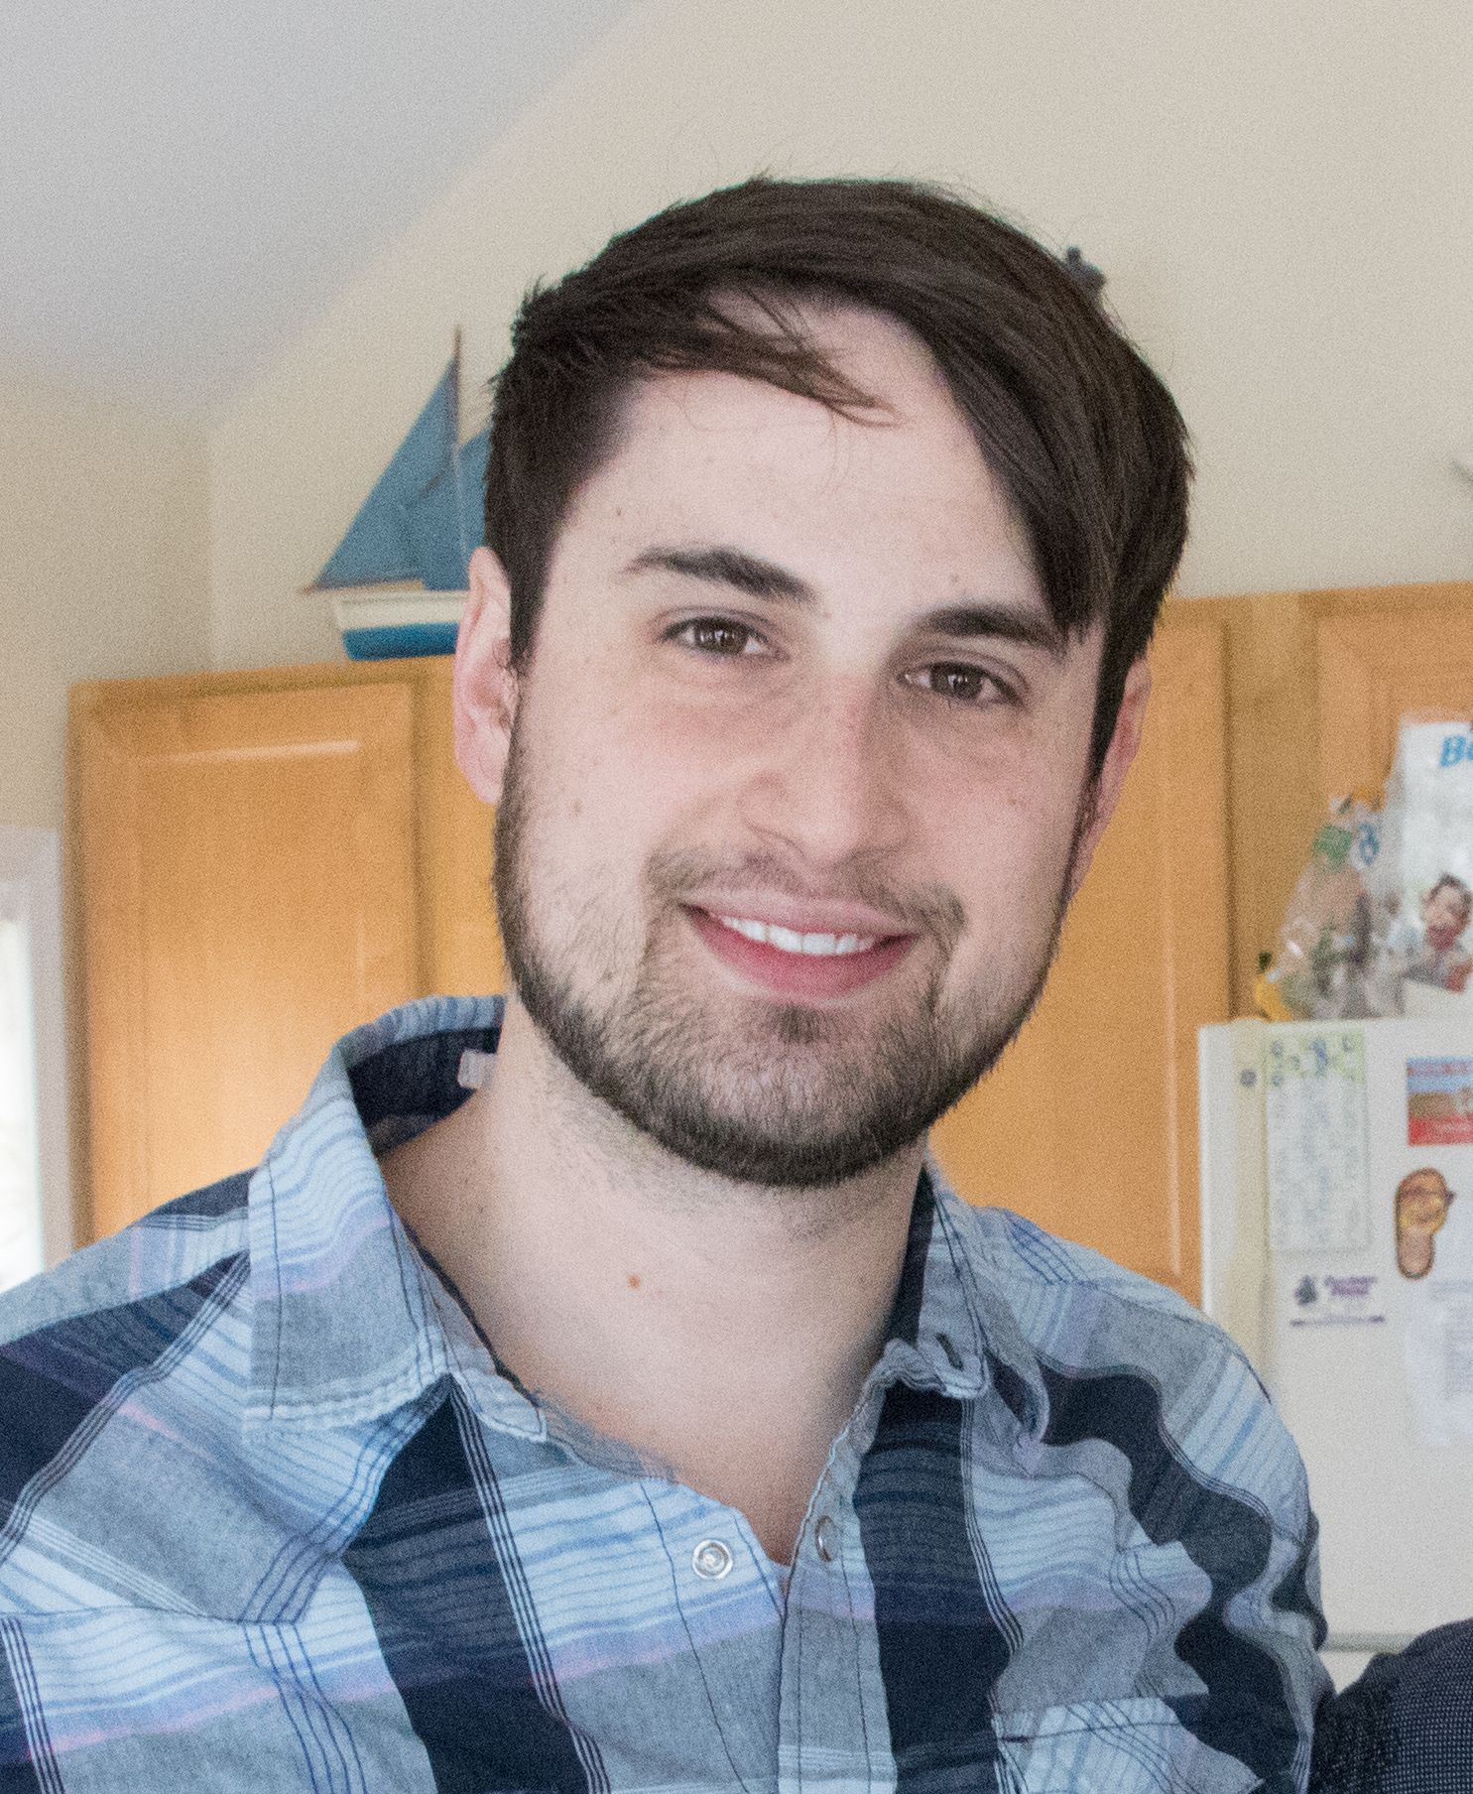
Dave Leonhardt
Instructor
I grew up in southern New Jersey and now live in the Fishtown area
I have a B.S. in Computer Science from Rowan University and am a former Application Engineer/Scrum Master
Outside of coding I enjoy playing guitar & bass, cooking, video games, and card games
Notes:
Instructors introduce themselves

Slide 12

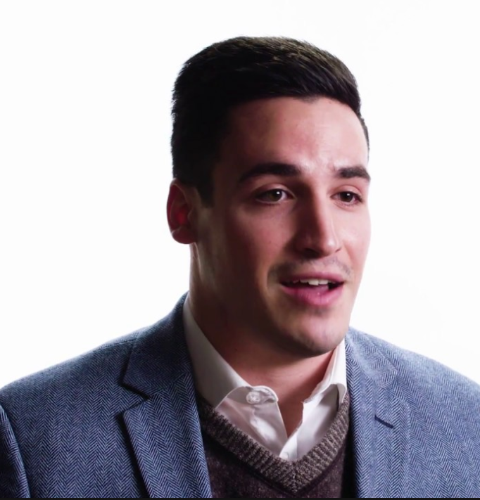
YOUR
CAREER SERVICES TEAM
PROFILE COACHES
CAREER COACH
YOU
Notes:
Delivered by SSM:
Intro to PC’s
Intro to CC
Primary and most important member of the CS Team is the Student themself.
Kyle Martinowich
Only in good standing in the course

Slide 13
PROGRESSION OF CAREER SERVICES
Individualized career support throughout job search
Months
3-6
Month 3
Continue interviewing practice
Learn to network
Start applications!
Individualized career support throughout job search
Month 2
Build a technical resume & portfolio
Start practicing interview skills
Month1
Understand the tech industry
Develop your brand statement & online presence
Notes:
Your Career Services experience is organized around a set of 7 Milestones that will lead you to Employer Competitiveness.
Milestones include:
Create Professional Materials
Polish your Portfolio
Prepare for Successful Interviews
Build Your Visibility

Slide 14


SUPPORT STRATEGIES
You are responsible for your success, but you’re not alone!
You
Schedule a Check-in with your SSM
Live Chat
on Bootcampspot
Tutoring sessions
Attend Office Hours
Form Study Groups
Notes:
Delivered by SSM:
Live Chat Tools:
Financial issues
Tutoring
General Support
FAQs
State Office Hours per respective markets.
To Students: “There’s puzzle pieces left to add and that’s where you come in. What will you add to your support strategies in this course?”

Slide 15
Activity: Landing Zones
Read this, then break into groups. (We’ll direct you)
2. As a group, decide on a meeting time and place for your study group on your assigned day of the week.
3. Post day and location in your Slack and pin.
4. Choose a speaker to share your decision with the class.

Slide 16
Minimum Graduation Requirements:
No more than 4 regular absences and 4 remote/excused absences (8 total)
Have no more than 2 incomplete homeworks
Hold at least a 70% average on homeworks
Hold at least a 70% average on group projects
Participate in all projects
Notes:
Remove % if not applicable to your university

Slide 17
Add/Drop Period
Ends Friday, January 31st at 11:59pm
Can withdraw with full refund
Must let me know
Notes:
Remove % if not applicable to your university

Slide 18


Pennovation Center
Co-working space/incubator owned by the University of Pennsylvania
Roughly 40 startups using the space
9 AM - 3 PM on weekdays (first floor only)
First floor use only
Cafeteria
Food trucks on Wednesdays!
Notes:
Remove % if not applicable to your university

Slide 19
Session Objectives Completed:
Come to know your classmates as the community that you will rely on for collaborative learning.
Know the staff who will be providing holistic support throughout the program.
Understand the minimum requirements in order to successfully graduate from this bootcamp.
Be able to list ways to get help and support at your moments of need.
Notes:
Delivered by SSM:
These Objectives are overarching and include Launch + 1.1 integration.

Slide 20
Questions?
Notes:
.

Slide 21

Break
See you back in 15 minutes!

Slide 22
The Zen of Coding
Lesson 1.1

Slide 23
The Path of Learning

Slide 24

Your Goals
Basically, 100% of you said new career.
Notes:
shutterstock_520041586

Slide 25
Your Goals
And why do you want a new career?
To pursue a dream
To escape a dead-end job
To be able to create
To follow a fascination
To attain financial stability
To obtain financial freedom
To challenge yourself
To be a role model to kids

Slide 26
Your Goal = Our Goal
As instructors, we take your goals very, very seriously.

Slide 27
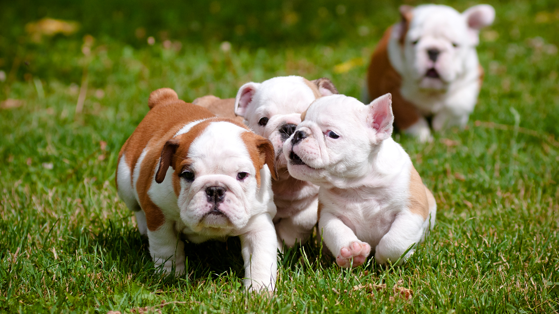
Support Team Promise
If you’re willing to put in the time and take our advice, we’re here to help you 100% of the way.
This goes for everyone working on this program:
Instructors
TAs
Student Success Team
Career coaches
Everyone else!
Notes:
shutterstock_137111177

Slide 28
But Remember:
Nothing good comes easily.

Slide 29
Our Keys to Success

Slide 30

Don’t Be This Person:
Notes:
Shutterstock_654566557

Slide 31

This Should Be You
Notes:
Shutterstock_667830277

Slide 32
Our Mantra for Today and Beyond
When it comes to web development…

Slide 33
I know nothing.

Slide 34
You.

Slide 35
The Path of Learning

Slide 36
Nothing comes easy.
As students, you face three
HUGE obstacles.

Slide 37

Obstacle #1: The Great Confusion
My code doesn't work and I don't know why.
My code works and I don't know why.
Notes:
Shutterstock_1188695488

Slide 38

Obstacle #2: The Great Doubt
“Maybe I’m just dumb.”
Notes:
Shutterstock_215771662

Slide 39

Obstacle #3: The Great Distance
Notes:
Shutterstock_411452953

Slide 40
Nothing Comes Easy
Learning to code requires two things:
01
Persisting in the face of something that feels incredibly hard and confusing.
02
Maintaining the self-confidence necessary to believe that YOU CAN DO THIS.

Slide 41

Learning Can Be Frustrating
You can’t tell whether you’re learning something when you’re learning it—in fact, learning feels a lot more like frustration.
What I’ve learned is that during this period of frustration is actually when people improve the most, and their improvements are usually obvious to an outsider. If you feel frustrated while trying to understand new concepts, try to remember that it might not feel like it, but you’re probably rapidly expanding your knowledge.
—Jeff Dickey, author of Write Modern Web Apps with the MEAN Stack: Mongo, Express, AngularJS, and Node.JS (Peachpit Press, 2014)

Slide 42
Advice for the Journey
Throughout this course, always remember to:
03
Trust yourself
Work hard!
01
02
Celebrate your successes

Slide 43
Advice for the Journey
Throughout this course, always remember to:
03
Trust yourself
Work hard!
01
02
Celebrate your successes

Slide 44
Advice for the Journey
Throughout this course, always remember to:
03
Trust yourself
Work hard!
01
02
Celebrate your successes

Slide 45
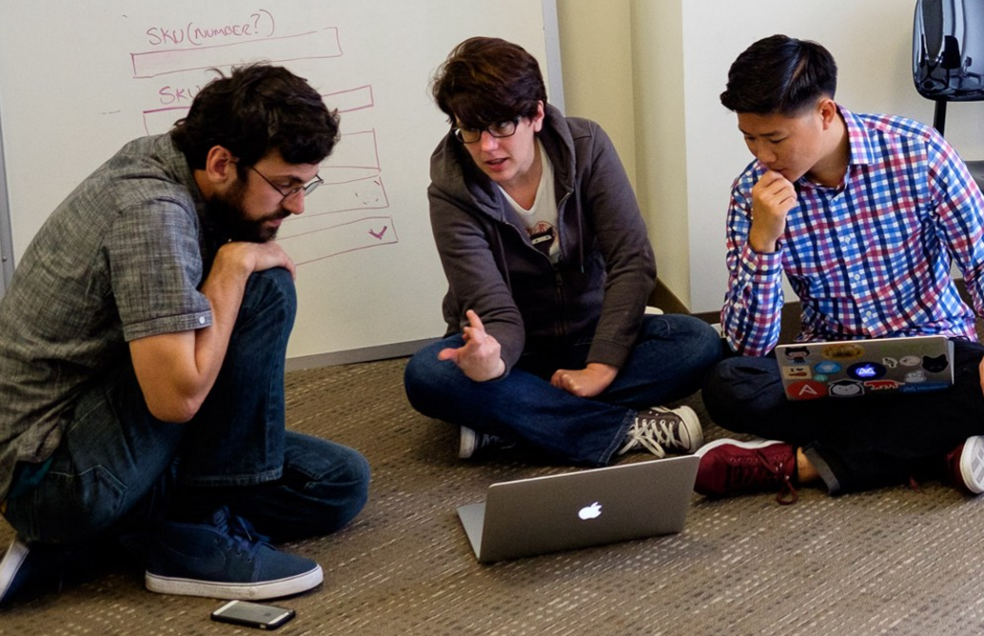
And Remember...
If you want to go fast, go alone. If you want to go far, go with a team.
Notes:
This is a Trilogy image of students and does not violate copyright laws.

Slide 46

Google Fu: The Most Important Skill of All
What Is Google Fu?
Notes:
shutterstock_653127499

Slide 47
Course Structure

Slide 48
Daily Schedule
In each class, we’ll cover the following:
Set objectives
Brief background lecture
Watch me / coding demos
Code discussions
In-class exercises
Project work

Slide 49

Daily Schedule
In each class, we’ll cover the following:
Set objectives
Brief background lecture
Watch me / coding demos
Code discussions
In-class exercises
This is the super important stuff—ALWAYS BE CODING!
Project work

Slide 50
Prework

Slide 51

<title>Intro to HTML</title>
How’d it go?

Slide 52
Software Checklist
At this point, you should have all of these installed:
Slack
Visual Studio Code
Git
Git Bash (Windows) or Terminal (Mac)
Node.js
Heroku-CLI
Google Chrome

Slide 53
Accounts Checklist
You should also have accounts for:
GitHub (with SSH Integration)
Heroku
LinkedIn
Stack Overflow

Slide 54
Self-Check
Let’s do some quick checks of the following:
Visual Studio Code Check
Git Bash/Terminal Check
Node Check
Git Check
Heroku Check

Slide 55
The Modern Web

Slide 56

What Exactly Is Full-Stack Development?

Slide 57

The “Magic” of YouTube
Notes:
shutterstock_1024261021

Slide 58




Full-Stack Development
FSF FLOW
In modern web apps, there’s a constant back-and-forth communication between two key components: the visuals displayed in the user’s browser (front end) and the data and logic stored on the server (back end).
Browser shows webpage to user
Web browser
Front end
User requests a webpage
Browser talks to Express
Express sends HTML back to browser
MySQL database
Node sends SQL
Node.js Express.js
Back end
MySQL returns rows
Node passes data to Handlebars
Handlebars renders HTML
Handlebars

Slide 59
Full-Stack Development
FSF FLOW
Full-stack development is the concept of building every aspect of the web application— from the visuals and interactions to the data transfer and processing.
Browser shows web page to the user
Web bowser
Frontend
User requests a web page
Browser talks to Express
Express sends HTML back to browser
MySQL Database
Node sends SQL
Node.js Express.js
Backend
MySQL returns rows
Node passes data to Handlebars
Handlebars renders HTML
Handlebars

Slide 60
Full-Stack Development
The Browser | Dev Tools | Server Side
HTML | Heroku | Templating engines
CSS | Git | Sessions
JavaScript | GitHub | Writing tests
jQuery | Databases | Node.js
Bootstrap | MySQL | Express.js
SEO | MongoDB | Creating APIs
API Interaction |  | MVC
APIs (Consuming) |  | User authentication
JSON |  | ORM (Sequelize)
AJAX |  | CS Fundamentals
Real-time cloud database via Firebase |  | Algorithms
Cutting-Edge Development |  | Design patterns
React.js

Slide 61
Let’s Get Crackin’!

Slide 62

Intro to Console/Terminal

Slide 63
Let’s Get Crackin’—Intro to Console

Slide 64
Activity: Console Commands
Instructions sent via Slack.
12 minutes

Slide 65
Activity: Console Commands
Suggested Time: 12 min
Instructions:
01
Create a new folder with the name of self-destructing-folder.
02
Create a new txt file with the name secret-message.txt.
03
Copy secret-message.txt to the inside of self-destructing-folder.
Delete the original secret-message.txt file.
04
Delete the self-destructing-folder.
05

Slide 66

Intro to Console: Discuss with Neighbors
Notes:
shutterstock_81648802

Slide 67
Hello, HTML

Slide 68
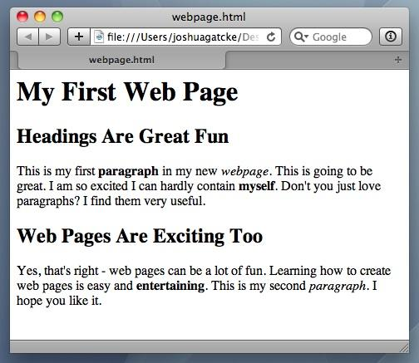
<title>Intro to HTML</title>
HTML5
HTML is one of the three base languages behind every website.
It defines all the basic content and a bit of formatting.
The Zen of Coding

Slide 69
Activity: Intro to HTML
Instructions sent via Slack.
5 minutes

Slide 70
Activity: Intro to HTML
Suggested Time: 5 minutes
In a new HTML file, create the basic structure of an HTML document and include the following in it:
DOCTYPE declaration
Head tag with a title tag
H1 tag with a title of your choice
An embedded image
Now add the following three links to your page:
One link that has target="_blank" so that it opens a new tab when clicked
One link that is bold
One link that is only a placeholder (it goes nowhere)
BONUS!
Create an ordered list of steps to make a sandwich
Create an unordered list of five bands/musicians you like
Create a table with two columns (animal class and animal name) and four rows of animals
Use an alternate way of separating links without line breaks
Embed a YouTube video of your favorite band/musician

Slide 71
My First HTML
Notes:
https://www.youtube.com/watch?v=ieb6Svbc10E&index=1&list=PLgJ8UgkiorCnMLsUevoQRxH8t9bt7ne14

Slide 73
What Is Git?

Slide 74












Collaborative Coding
Modern web development is highly collaborative.
Teams are often extremely large and spread out across the country or world.
Apps are sometimes made up of hundreds or even thousands of files.
Git Version Control
Final
Originals
Change Requests
Developers

Slide 75
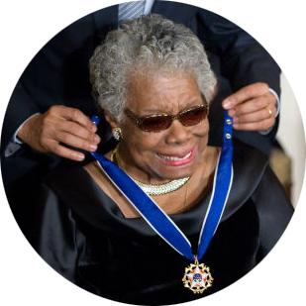
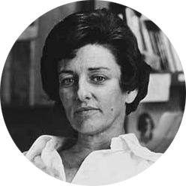
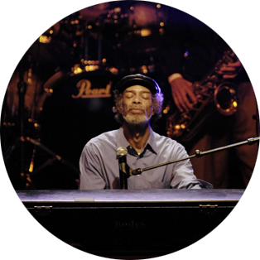
The Team’s Task
Make a list of creative works you’ve written in the past.
Programming Team
Maya Angelou | Anne Sexton | Gil Scott Heron

Slide 76

Maya Angelou & Gil Scott Heron Make Their Edits
Maya Angelou is programming away.
Maya Angelou’s version
<ul>
<li>On the Pulse of Morning</li> <li>I Know Why the Caged Bird Sings</li> <li>And Still I Rise</li>
</ul>
Gil Scott Heron is programming away.
Gil Scott Heron’s version
<ul>
<li>Free Will</li> <li>Pieces of a Man</li> <li>The Revolution Will Not Be Televised</li>
</ul>

Slide 77

Different Solutions
Maya Angelou’s version
Gil Scott Heron’s version
<ul>
<li>On the Pulse of Morning</li> <li>I Know Why the Caged Bird Sings</li> <li>And Still I Rise</li>
</ul>
DIFFERENT
<ul>
<li>Free Will</li> <li>Pieces of a Man</li> <li>The Revolution Will Not Be Televised</li>
</ul>

Slide 78
Resolution
Maya Angelou’s version
Let’s settle on this:
<ul>
<li>Poems</li>
<li>Albums</li>
<li>Songs</li>
</ul>
<ul>
<li>On the Pulse of Morning</li> <li>I Know Why the Caged Bird Sings</li> <li>And Still I Rise</li>
</ul>
Gil Scott Heron’s version
<ul>
<li>Free Will</li> <li>Pieces of a Man</li> <li>The Revolution Will Not Be Televised</li>
</ul>

Slide 79
Anne Sexton Writes Her Own Version
Anne Sexton’s version
<ul>
<li>The Double Image</li>
<li>Heart’s Needle</li>
<li>Baby Picture</li>
</ul>

Slide 80
Anne Sexton Overwrites the Work of Her Teammates
Delete. Delete.
Delete. Delete.
Delete. Delete.
<ul> <li>Poems</li> <li>Albums</li> <li>Songs</li> </ul> | <ul> <li>The Double Image</li> <li>45 Mercy Street</li> <li>The Road Back</li> </ul>

Slide 81

The Group Project
Lesson: You should use version control because it helps you manage multiple developers working on a single codebase.
“Today we fret and pull on wheels, ignore our regular loss of time…” Or maybe we should just use Git.

Slide 82
Git Version Control
Git provides an organized system for managing code when multiple developers work on a project at the same time.
The Benefits of Git
01
A process for resolving conflicts in code
02
Version history

Slide 83
The Group Project
Branch = personal copy
Master Branch
Personal Branch
Maya’s Personal Branch
Anne’s Personal Branch
Gil’s Personal Branch

Slide 84
The Team Goes to Work
Maya Angelou’s version
<ul>
<li>On the Pulse of Morning</li>
<li>I Know Why the Caged Bird Sings</li>
<li>And Still I Rise</li>
</ul>
Gil Scott Heron’s version
<ul>
<li>Free Will</li>
<li>Pieces of a Man</li>
<li>The Revolution Will Not Be Televised</li>
</ul>

Slide 85

Maya Angelou Pushes First
Maya Angelou pushes (uploads) her code changes into the main branch.
No code conflicts
1
Master Branch
Maya’s Personal Branch

Slide 86
Rule: Pull first, and then push your changes.

Slide 87
Gil Scott Heron’s Edits Are Ready
Rule: Pull first, and then push your changes.
1
Master Branch
Gil’s Personal Branch

Slide 88

Gil Scott Heron Conflicts with the Master Branch
Git sees a conflict.
<ul>
<li>On the Pulse of Morning</li>
<li>I Know Why the Caged Bird Sings</li>
<li>And Still I Rise</li>
<li>On the Pulse of Morning</li>
<li>I Know Why the Caged Bird Sings</li>
<li>And Still I Rise</li>
</ul>
1
Master Branch
Gil’s Personal Branch

Slide 89
Kobe Resolves
<ul>
<li>On the Pulse of Morning</li>
<li>I Know Why the Caged Bird Sings</li>
<li>And Still I Rise</li>
<li>On the Pulse of Morning</li>
<li>I Know Why the Caged Bird Sings</li>
<li>And Still I Rise</li>
</ul>
<ul>
<li>Poems</li>
<li>Albums</li>
<li>Songs</li>
</ul>
Gil’s Personal Branch

Slide 90
Gil Scott Heron Fixes and Pushes
Gil pushes (uploads) his revision to the main branch.
No code conflicts
1
2
<ul>
<li>Poems</li>
<li>Albums</li>
<li>Songs</li>
</ul>
Master Branch
Gil’s Personal Branch

Slide 91
Anne Sexton Starts Her Work
Rule: Pull first, and then push your changes.
look into my face
and you will know that crimes dropped upon me
as from a high building…
…by which I mean, I broke the rules.

Slide 92
Anne Sexton Pushes
Anne Sexton pushes (uploads) her revision to the main branch, but she doesn’t pull first. Because she did not pull first, she sees no conflicts in the code (and doesn’t get Gil’s work!). This is not what we want.
1
2
3
Master Branch
<ul>
<li>The Double Image</li>
<li>Heart’s Needle</li>
<li>Baby Picture</li>
</ul>
Anne’s Personal Branch

Slide 93
If Anne Had Made a Pull First...
Conflict!
<ul>
<li>The Double Image</li>
<li>Heart’s Needle</li>
<li>Baby Picture</li>
</ul>
<ul>
<li>Poems</li>
<li>Albums</li>
<li>Songs</li>
</ul>
CONFLICT!

Slide 94
The overwritten work is discovered!

Slide 95
Roll Back
Maya rolls back the code to an earlier version.
x
1
2
3
4
Master Branch
x
Anne’s Personal Branch

Slide 96
Activity:
Explain Git (Version Control)
3 Minutes

Slide 97
Activity: Explain Git (Version Control)
Suggested Time: 3 Minutes
Turn to your neighbor, and have one of you explain to the other:
The concept of version control
Then, the other should explain:
Two key advantages of using a version control system

Slide 98
What Is GitHub?
GitHub is a web-based hosting service to store code online.
It allows developers to pull (download) code or push (upload) code to the same repository (directory).
It also allows developers to view histories of code changes and track issues.

Slide 99
Pushing and Pulling to GitHub
1
2
3
4
GitHub Branch
Pull Code
Push Code
Pull Code
Push Code
Pull Code
Push Code

Slide 100
Get Started with Git

Slide 101
Git

Slide 102
Basic Git Commands
These are the five basic Git commands to get started:
git clone
git add
git commit
git push
git pull

Slide 103
Basic Git Commands
git clone | Copies an entire repo (to begin)
git add | Adds a file for inclusion in Git
git commit | Notes a change to the local repo
git push | Sends changes to hosting service
git pull | Downloads freshest version of repo

Slide 104
Challenge: Git Add, Commit, Push
15 minutes

Slide 105
Activity: Git Add, Commit, Push
Suggested Time: 15 Minutes
Using GitHub and the command line:
Create a new public GitHub repository and name it whatever you like. Be sure to check the box to initialize this repository with a README.
Clone the repo to your local directory.
Create an HTML file inside the local directory.
Add, commit, and push the code to GitHub.
Bonus:
Find a partner in class, and fork their repository to your own GitHub account. Clone this forked repository to your local directory.
Add, commit, and push the code back to your forked copy.
Submit a pull request to send your changes to your partner’s repo.

Slide 106

Still a Bit Lost? Don’t Worry!
Follow this handy guide!
Practice a few times on your own before the next class.
Notes:
Send out Steps To Upload to Github.pdf

Slide 107
If you’re still lost, here’s a (free) course on how to use GitHub:
codeschool.com/courses/try-git

Slide 108
Homework Assignment
Next Class

Slide 109
Homework Assignment
Due Date: Next Class
01
Figure out where the GitHub repo is for our class.
02
Redo the Terminal example from today’s class.
03
Redo the HTML example from today’s class. (Watch the walkthrough video if you feel a bit lost.)

